Slide 1
Proteomics clustering for high-titer strains

Slide 2
Identifying useful strains to scale up
We would like to test out our “best” strains at higher scales, which leads to questions:
How many to test? Which strains?
What are we expecting to see upon scale up? How much better will each strain perform.
Scale up changes (amongst other things) oxygenation and several of our perturbed proteins have to do with ETC
We could simply select the top N strains.
What if these all have similar proteomics profiles which are incompatible with scale—up conditions?
We could cluster strains using proteomics and identify different types of high-titer strains, then select form each type, to get more diversity in our scale-up

Slide 3
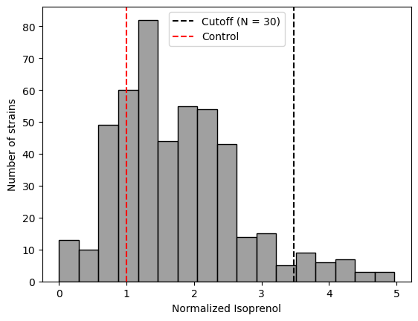
Distribution of titers – selecting the top N strains
Using a cutoff of N = 30, we have strains with titers > 3.5x control

Slide 4
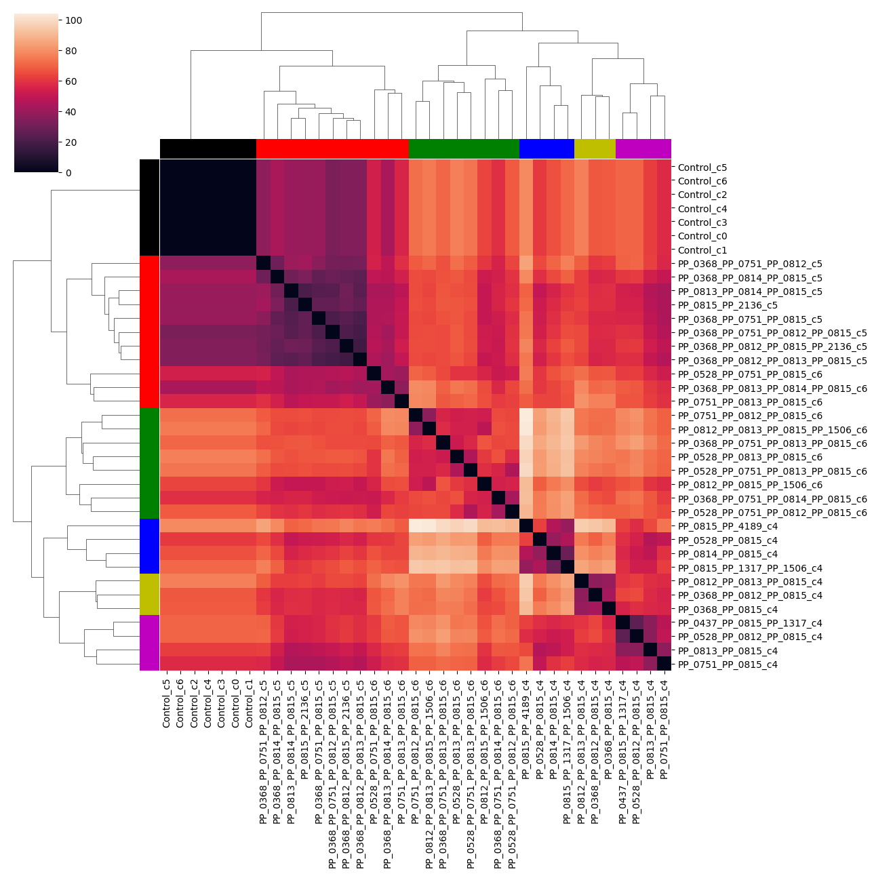
Distance-based clustering
Calculating the distance in normalized proteomics space

Slide 5
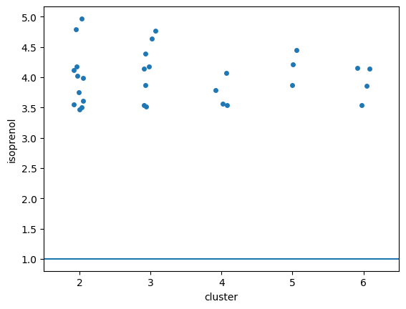
High-titer strains are in all clusters

Slide 6
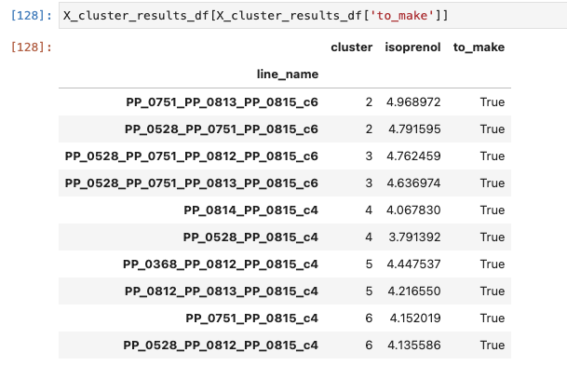
Taking top 2 strains from each cluster

